Slide 2
Ranking
Use a Probabilistic Model for ranking of data
It caters to the terms held by a document and whether that same set of terms is held by other documents
The more documents mentioning the term the higher the rank of the document

Slide 3
Ranking
Terms can be assigned weights so that more important terms can realize higher weights for documents carrying them

Slide 4
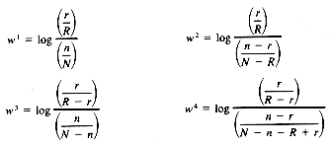

Formula Used
N = the number of documents in the collection
R = the number of relevant documents for query q
n = the number of documents having term t
r = the number of relevant documents having term t
N = the number of documents in the collection
R = the number of relevant documents for query q
n = the number of documents having term t
r = the number of relevant documents having term t
Q = the number of matching terms between document j and query k
C = a constant for tuning the similarity function
n_{i} = the number of documents having term i in the data set
N = the number of documents in the data set

